Slide 1
Global PSP Project for Indian Embassies and Consulates
Quick Guide – Granting Officer (GO) Users’ Application

Slide 2
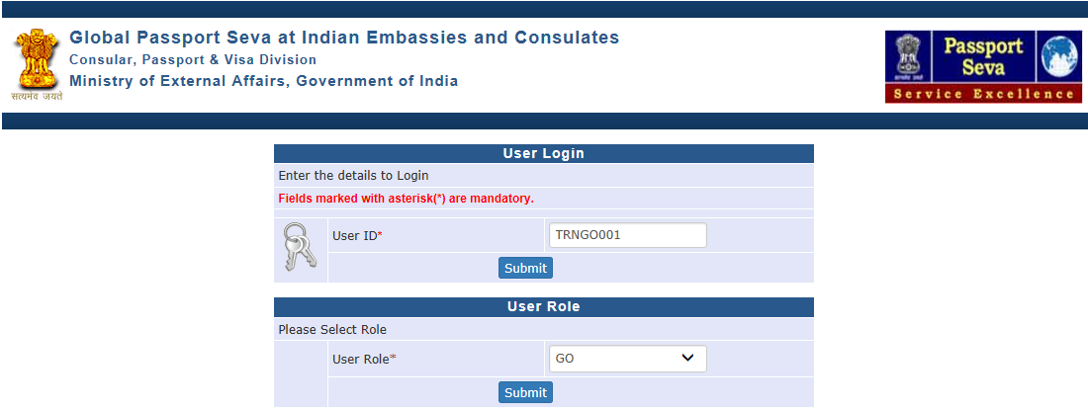
Login Using User ID, Password, and Grid Values
Visit Global PSP Office Portal (https://embassy.passportindia.gov.in)
Enter User ID
Press Submit button
Choose User Role as ‘GO’
Press Submit button displayed below the User Role

Slide 3
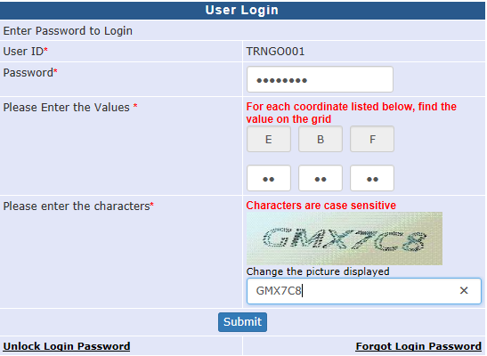
Login Using User ID, Password, and Grid Values (continued..)
Enter Password
Check your User Grid and enter the values for the three alphabets displayed on the screen
Enter the characters displayed in the CAPTCHA image
Press Submit button

Slide 4
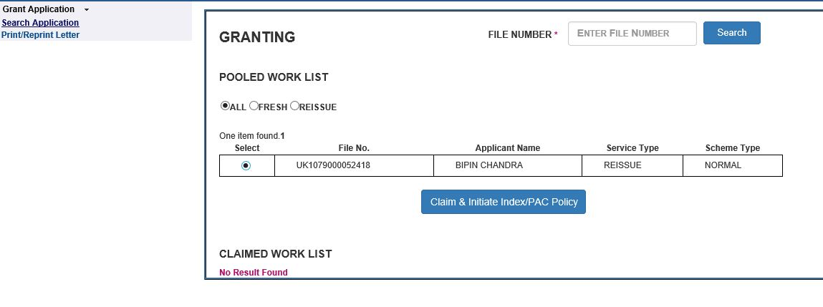
Grant Application screen
Grant Application screen displays the Pooled and Claimed Work-items’ list
Items displayed in Pooled Work list can be claimed for processing by any GO user in the respective Mission/Post (visible to all GO users)

Slide 5
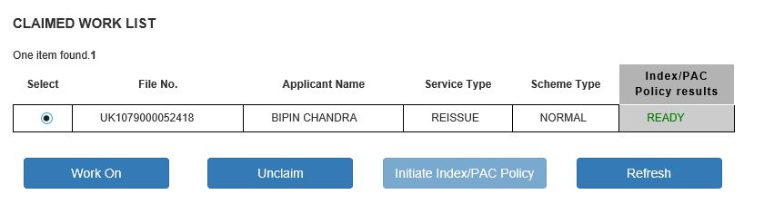
Grant Application screen (continued..)
Items in Claimed Work list displayed with Index/PAC result as ‘Ready’ can be processed by the logged user
Items in Claimed Work list displayed with Index/PAC status as 'Not Ready' or 'In Progress' can be processed after initiating the Index/PAC check by clicking on 'Initiate Index/PAC Policy'
Notes:
Ideally choose a screenshot showing both varieties of Index Check Readiness status

Slide 6
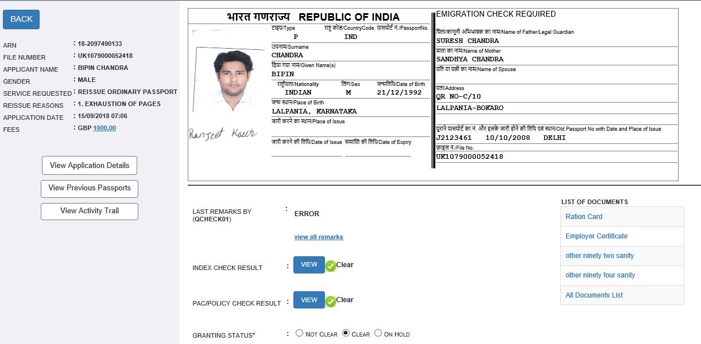
Grant Application screen (continued..)
Application details for the selected file will appear after pressing the Claim button in worklist screen
Passport Print Preview for the selected application is displayed upfront
Separate buttons for viewing the details of previous passport and that of current application/activity trails are displayed on screen

Slide 7
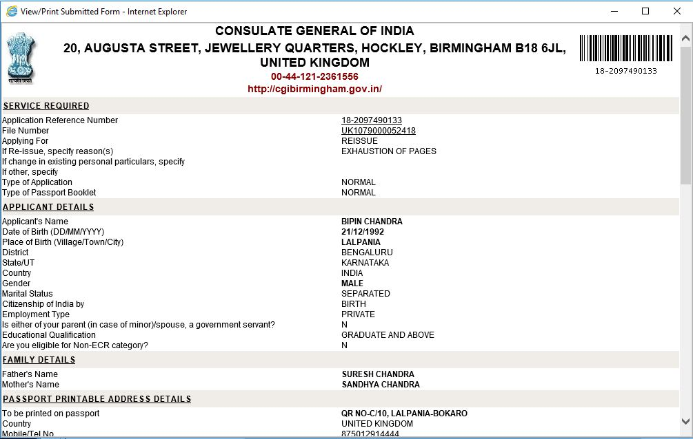
View Application Details sub-screen
This sub-screen opens when View Application Details button is clicked in the Grant Application (work-on mode) screen
All application form fields are visible in this screen

Slide 8
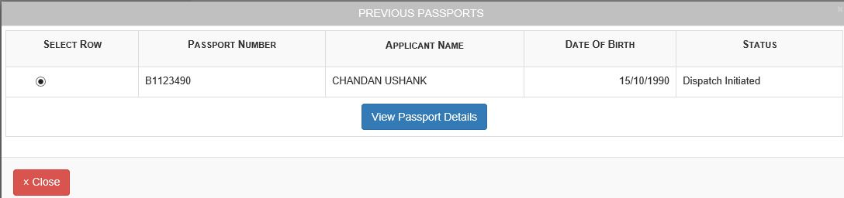
Previous Passports sub-screen
This sub-screen opens when View Previous Passports button is clicked in the Grant Application (work-on mode) screen
List of previous as well as all past passports linked with the application is displayed in chronological order of issuance

Slide 9
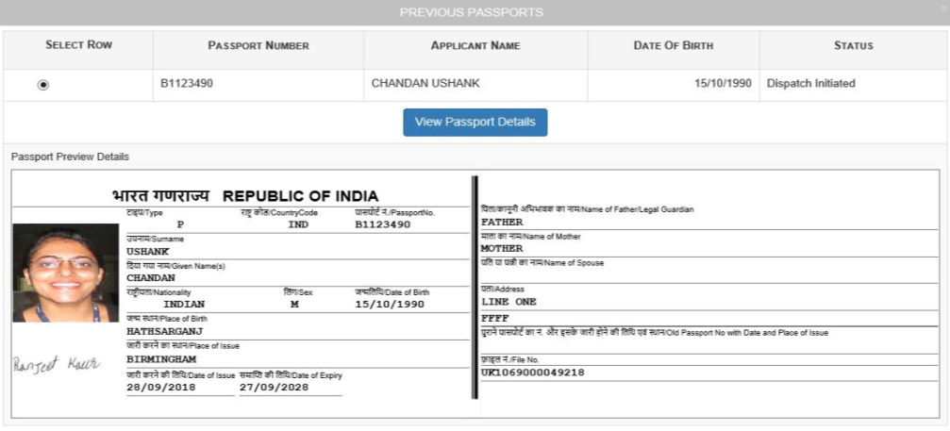
Previous Passports sub-screen (continued..)
Select the desired previous passport record by clicking the radio button displayed under Select Row column and click on the View Passport Details button to view the Passport Preview Details sub-screen.

Slide 10
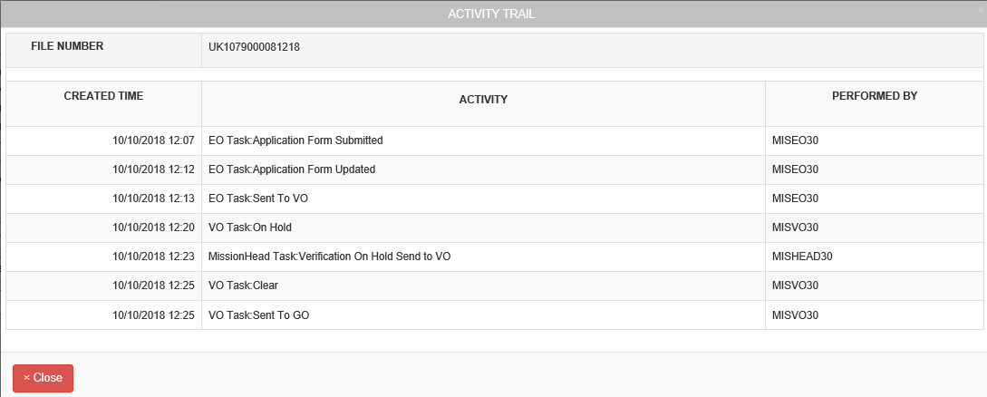
View Activity Trail sub-screen
This sub-screen opens when View Activity Trail button is clicked in the Grant Application (work-on mode) screen
The screen displays the chronological list of EO-VO-GO-Mission Head processing activities carried so far for the selected application

Slide 11
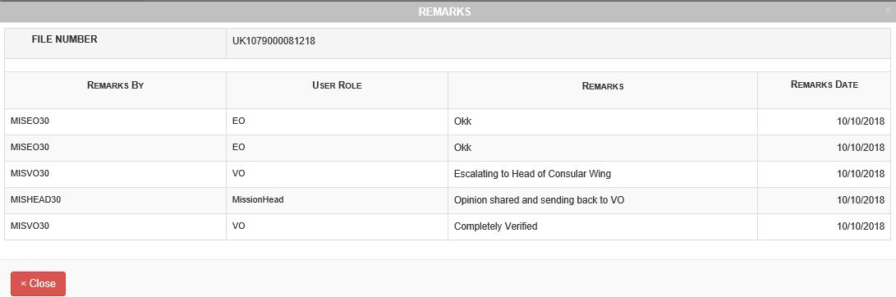
View All Remarks sub-screen
This sub-screen opens when View All Remarks button is clicked in the Grant Application (work-on mode) screen
The screen displays the chronological list of application processing remarks entered so far for the selected application by various roles’ users who acted on the application

Slide 12
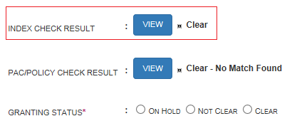
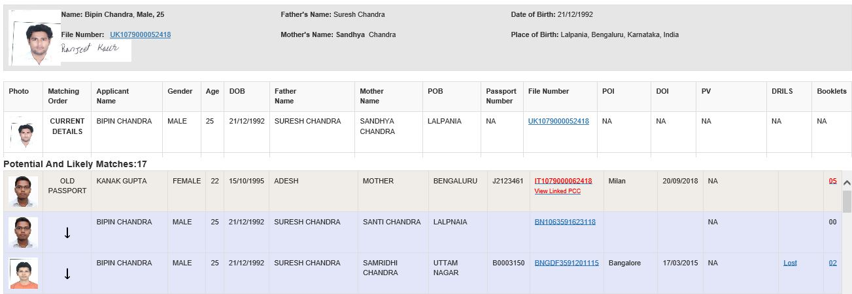
View Index Check Result
Click on View button displayed besides the Index Check Result field in the Grant Application screen to view the matching records.

Slide 13
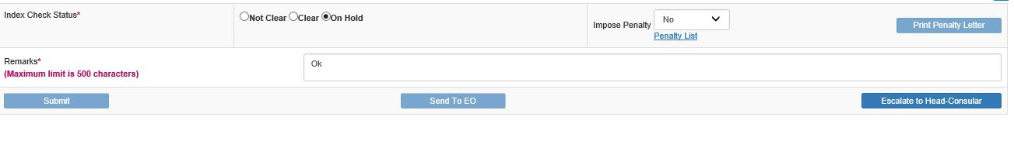
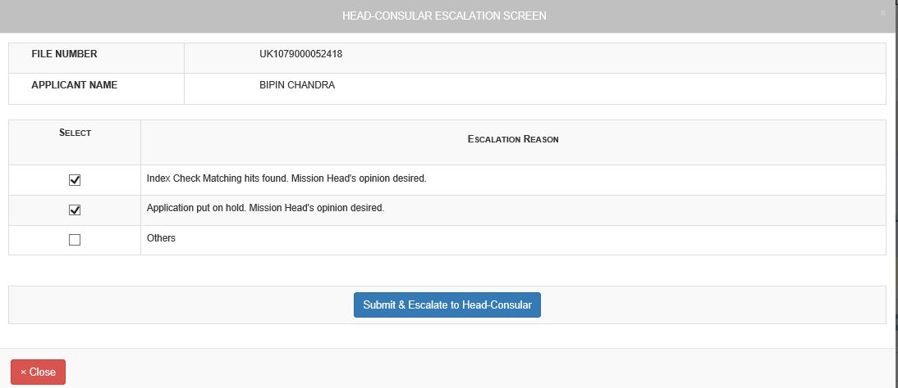
View Index Check Result (continued..)
GO users can escalate the file to Head-Consular if matching records are found and Head-Consular opinion is required to decide on Information Suppression case.

Slide 14
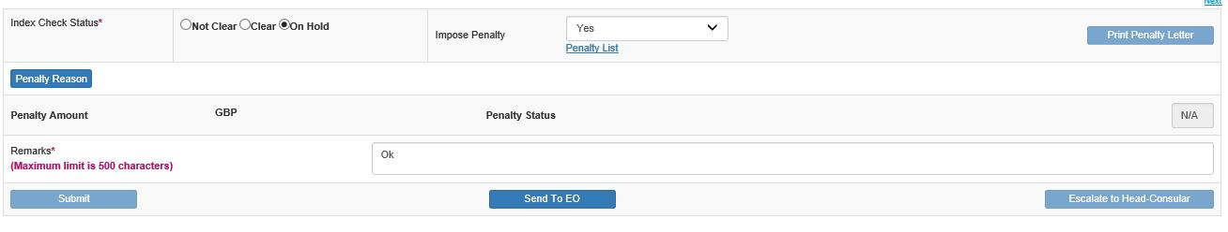
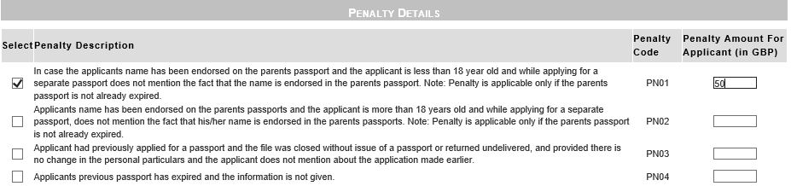
View Index Check Result (continued..)
By selecting Index check status as 'On Hold' and Impose Penalty as Yes, GO users can impose penalty in case the event of suppression of any important information (like presence of an undeclared previous passport) is established.
Click on Penalty Reason button to choose penalty reason and amount

Slide 15
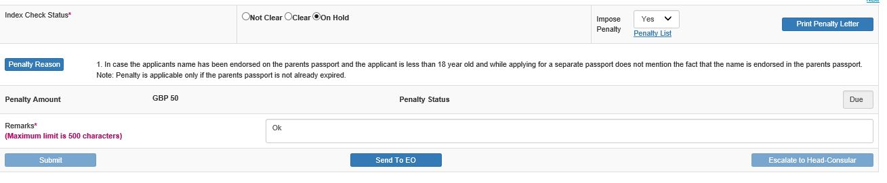
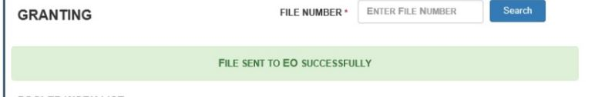
View Index Check Result (continued..)
Select the Penalty Reason and enter corresponding penalty amount and click on Select and Return.
Print the penalty Letter by clicking on the Print Penalty Letter button
Click on Send to EO button to transfer the application flow to Enrolment Officer (EO) users for collection of Penalty amount from the applicant. The GO may also mention in Remarks in case any data modification is also required.

Slide 16
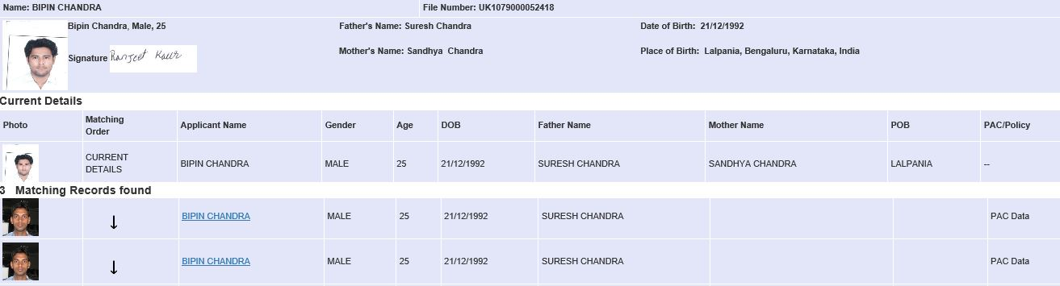
View PAC/Policy Check Result
Click on the View button displayed besides the PAC/Policy Check Result field in the Grant Application screen to view the matching records, if any

Slide 17
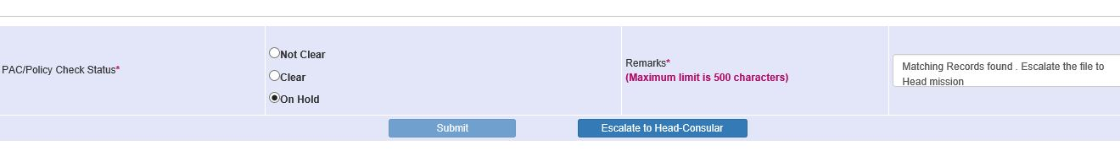
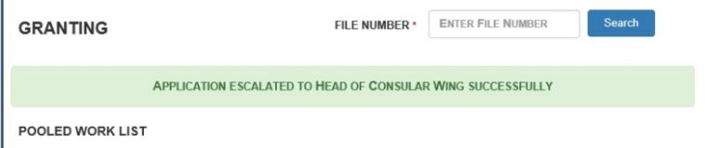
View PAC/Policy Check Result (continued..)
GO user may escalate the case to Head-Consular for his/her instructions/guidance for further processing in case of any PAC/Policy match records by choosing PAC/Policy Check Status as ‘On Hold’, entering Remarks expressing the query, and clicking on the 'Escalate to Head-Consular‘ button

Slide 18
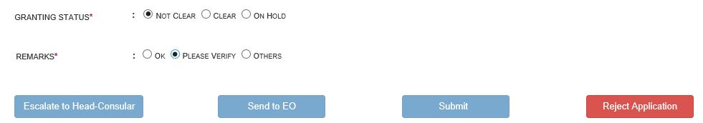
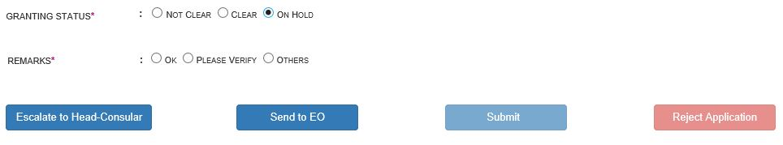
Granting Status
GO User may choose the Granting Status as Clear, Not Clear or On Hold:
If Not Clear is chosen – GO may Reject the application
If On Hold is chosen – GO may either escalate to Head-Consular (for query) or send back the case to EO (for data/document corrections)
If Clear is chosen - GO User may complete the Granting after selecting the Granting Decisions like Passport Validity (Countries/Years) (PTO)

Slide 19
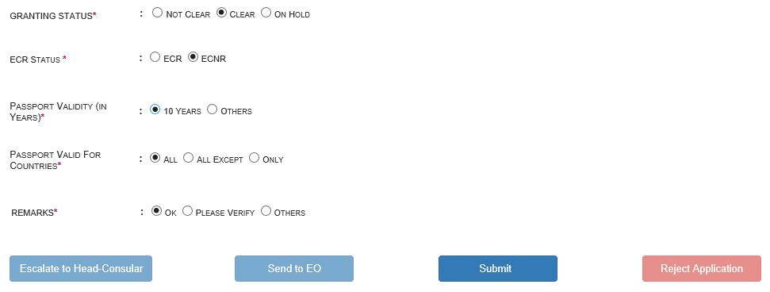
Granting Status (continued..)
If Granting status is chosen as 'Clear‘ - ECR Status and Passport Validity (duration and countries) is to be finalized by the GO
Passport Validity duration can be chosen in terms of number of years/months (default: 10 years) or till a specific date
Passport Validity in terms of list of countries can be chosen as ‘All’ (default, indicating passport will be valid for all countries), ‘All Except Iraq/Israel/Taiwan, or Only for Iraq/Israel/Taiwan/Saudi Arabia
Press Submit after making the Granting decision

Slide 20
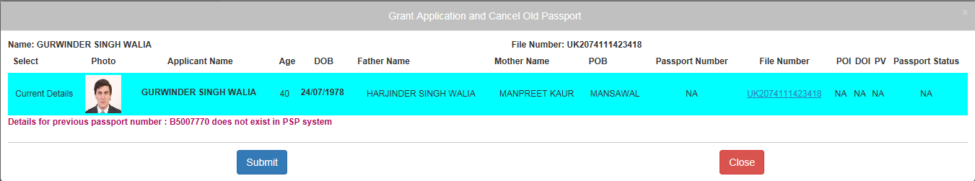
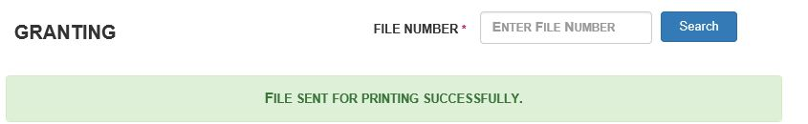
Granting Status (continued..)
In case of Reissue application, the ‘Grant Application and Cancel Old Passport’ sub-screen, displaying details of current and previous passport, is displayed.
GO must choose the correct old passport record to confirm that the same is being physically cancelled by him/her as part of granting of the new (current) application
Passport printing will be initiated and old passport number will be cancelled in the system as soon as Granting is done
Notes:
Replace screenshot displaying a VALID PASSPORT in place of Old Passport. Make sure the same belong to the same Applicant Name (this screen shot shows BIPIN CHANDRA and KANAK GUPTA)

Slide 21
In case of additional information or clarification, please contact Global PSP Support Team at
Email : global.psp@tcs.com
Phone: +91-0120-672-9595/96
Mobile: +91-730-351-9595
Thank You

